Slide 1
ASTRONOMY WEB DESIGN PLAN
Web Programming/Multimedia Design Midterm presentation

Slide 2
Introduction:
The idea behind the design and programming of the website is to have a space/astronomy themed website.
Scientific information will be given about outer space (our own solar system and other ones).
News regarding new research and space agencies such as NASA, SpaceX etc will also be included.
The multimedia of the website will include (banners), visual and auditory multimedia such as videos or sound representations. For example there are audios picked from different planets such as Mars or Saturn from satellites and rovers such as Voyager satellites or Spirit, Opportunity, Sojourner etc.
Gifs will be included as well for a more vivid representation.

Slide 3
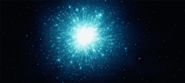
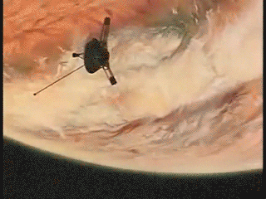
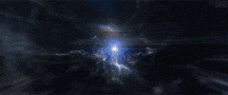
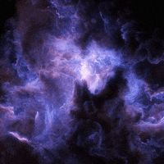
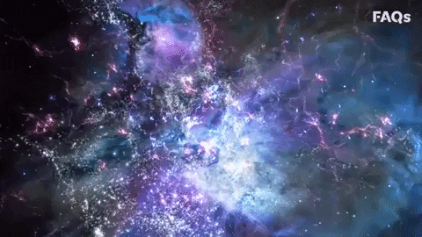
GIFS:

Slide 4
Audıtory multımedıa
All Planet Sounds From Space (In our Solar System) - YouTube

Slide 5
SCOPE & GOAL
Who are the target of interest of the website

Slide 6
The scope of the website is nothing but educational. My goal is to give the client or visitors knowledge and information about outer space. Can be visited by everyone who takes an interest. Even though astronomy is indeed a science, the website will not consist of physics/mathematics etc. rather than a general information that can be comprehended by anyone.
WHO IS THE TARGET AUDIENCE?
Anyone can be. The website is free and the audience can be anybody. A teenager, a student, an adult, right about anybody who has an interest on such subjects and wants to learn more.

Slide 7
WHY VISIT?
”The nitrogen in our DNA, the calcium in our teeth, the iron in our blood, the carbon in our apple pies were made in the interiors of collapsing stars. We are made of starstuff”.
-Carl Sagan

Slide 8
Why visit? Because space is fascinating. The more you know, the less you feel that you know anything. The universe is so vast that we quite literally cannot even conceptualize such magnitude. ANYTHING can exist in it. Any sort of star/planet or life. Everybody has wondered at some point about the fermi paradox and where the aliens are this is also one of the big researches that scientists of different space agencies are focused upon alongside with many others such as the string theory/multiverses etc.

Slide 9
FINDING AUDIENCE
Finding audience for a brand new website can be hard, one way to find an audience for this kind of website is by reaching out to others. There are a lot of
people invested in astronomy whether it’s just people that like to read about it,
Researchers, amateurs etc. these people are willing to spend some time on
webpages as this one and are very good people to count on for feedback.
Another way is advertising your website such as social media, google ads etc.

Slide 10
WHY THIS WEBSITE?
-No annoying and unrelated pop-ups.
-Completely free.
-Suited for anyone who is interested in this subject, there is no higher level astrophysics or complicated terms.
-Feedback is welcomed.
-Will give links to professional websites for more & valid information.
-Astronomy is cool.

Slide 11
Studyboard

Slide 12
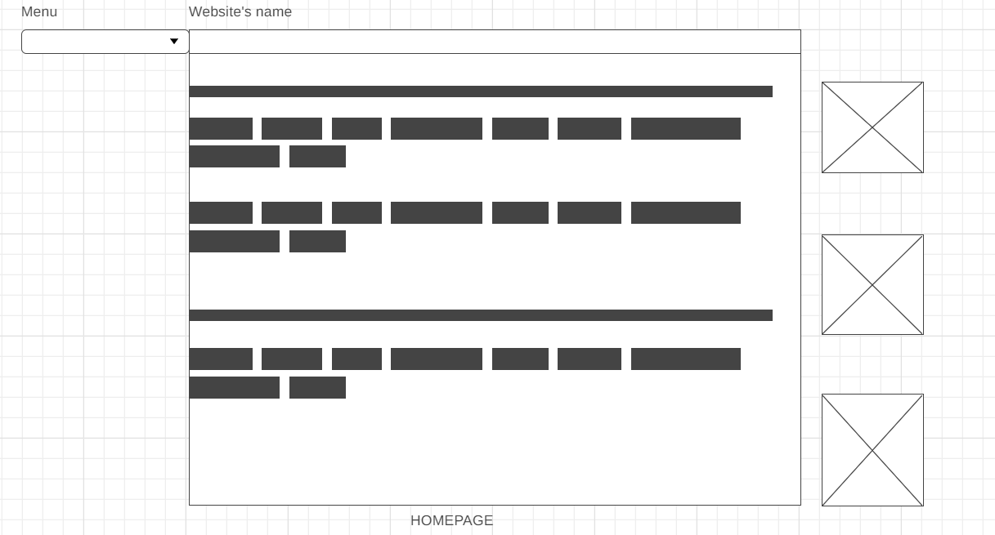
HOMEPAGE DESIGN DESIGN
The boxes outside the homepage are the news headlines

Slide 13
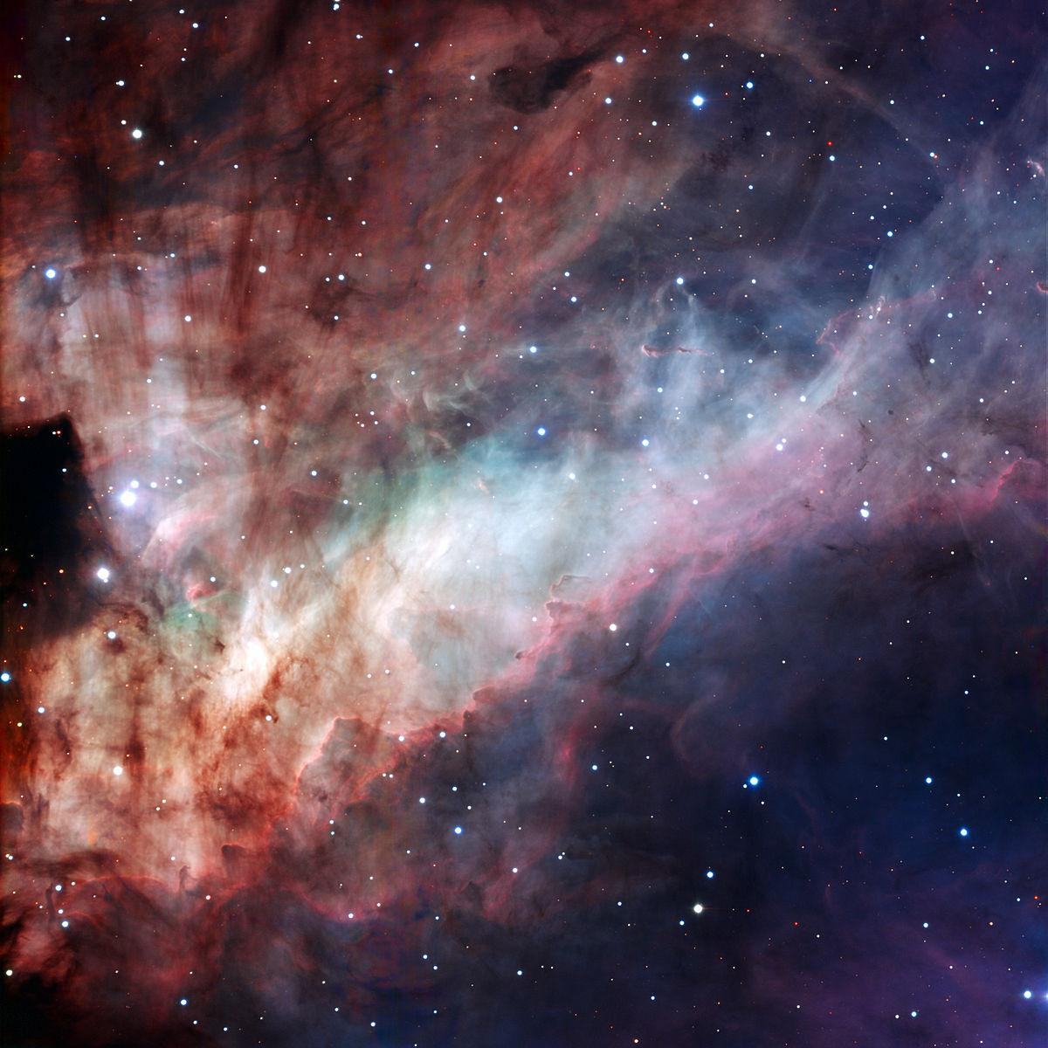
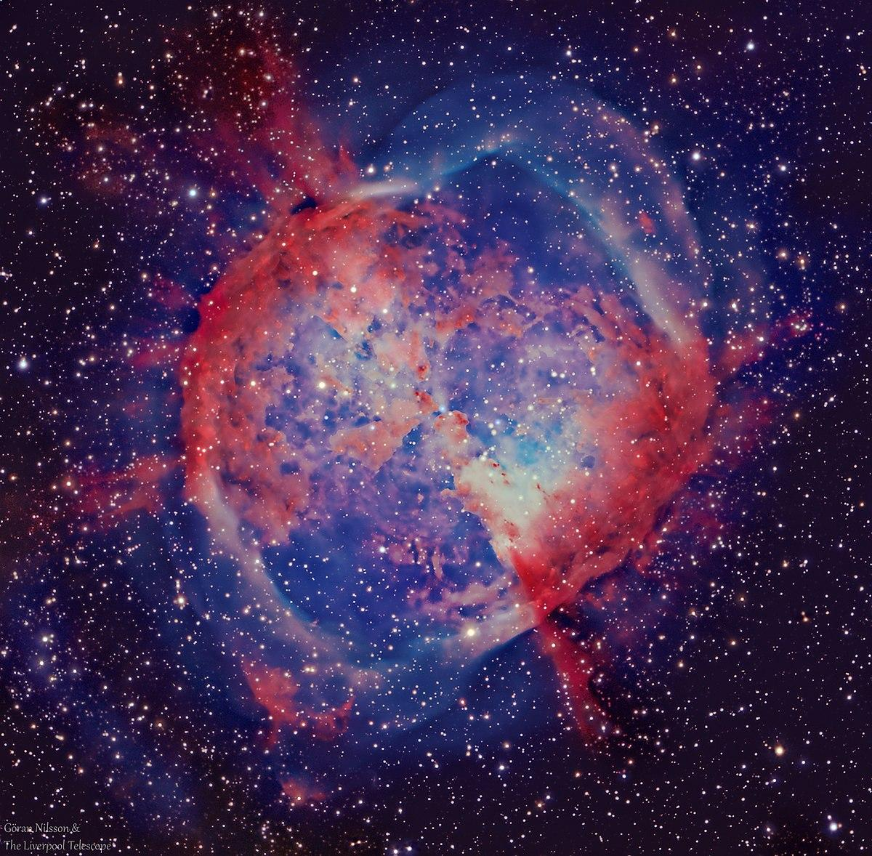
COLORS:
Soft Colors (pastel colors) will be used.
I don’t want the website to have just a white background, I want it to mimic a nebulae formation of different colours, but pastel so it doesn’t hurt the eyes when the visitors are reading something out of it. A combination of white, violet, blue and green for a soft background.

Slide 14
WEBSITES OF INSPIRATION:
Universe app on play store. Although a mobile application the creator has done a very good job with the design.
Different space agency websites such as NASA, ESA, SpaceX, CSA etc. can also be helpful for a desktop design and information.
https://www.nasa.gov
https://www.esa.int
https://www.spacex.com
https://asc-csa.gc.ca/eng/Default.asp

Slide 15
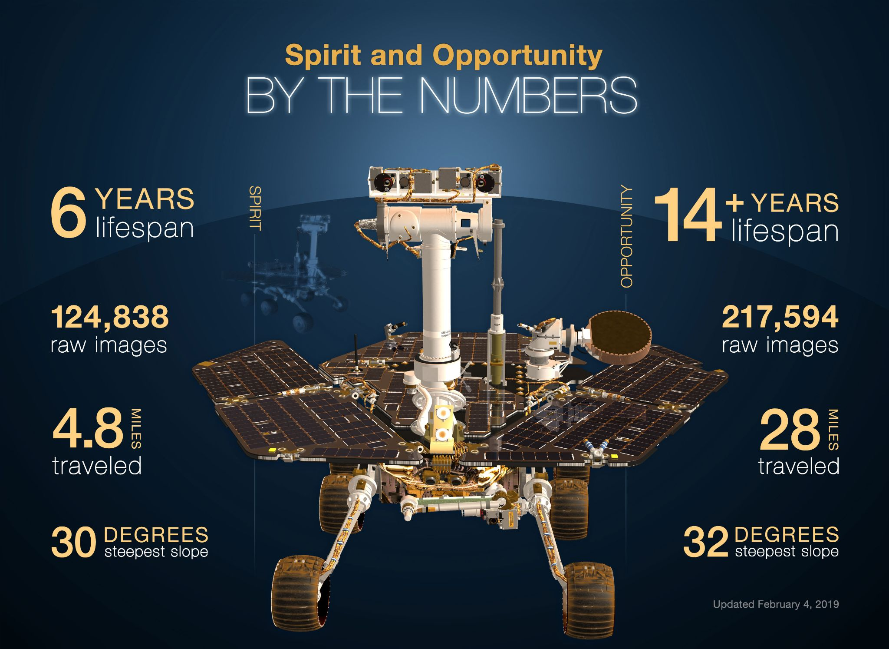
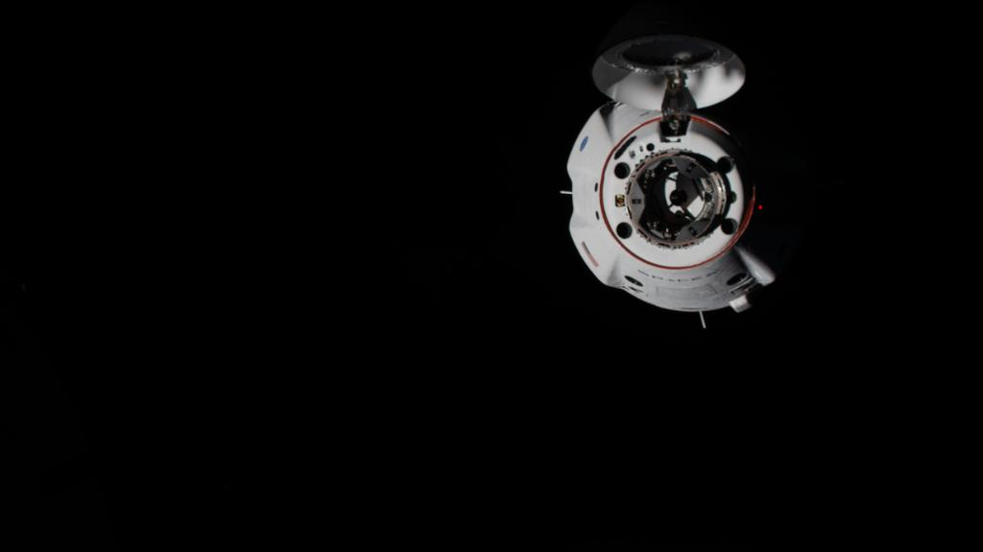
PHOTOS
Taken from NASA’s twitter account
Taken from NASA’s website

Slide 16
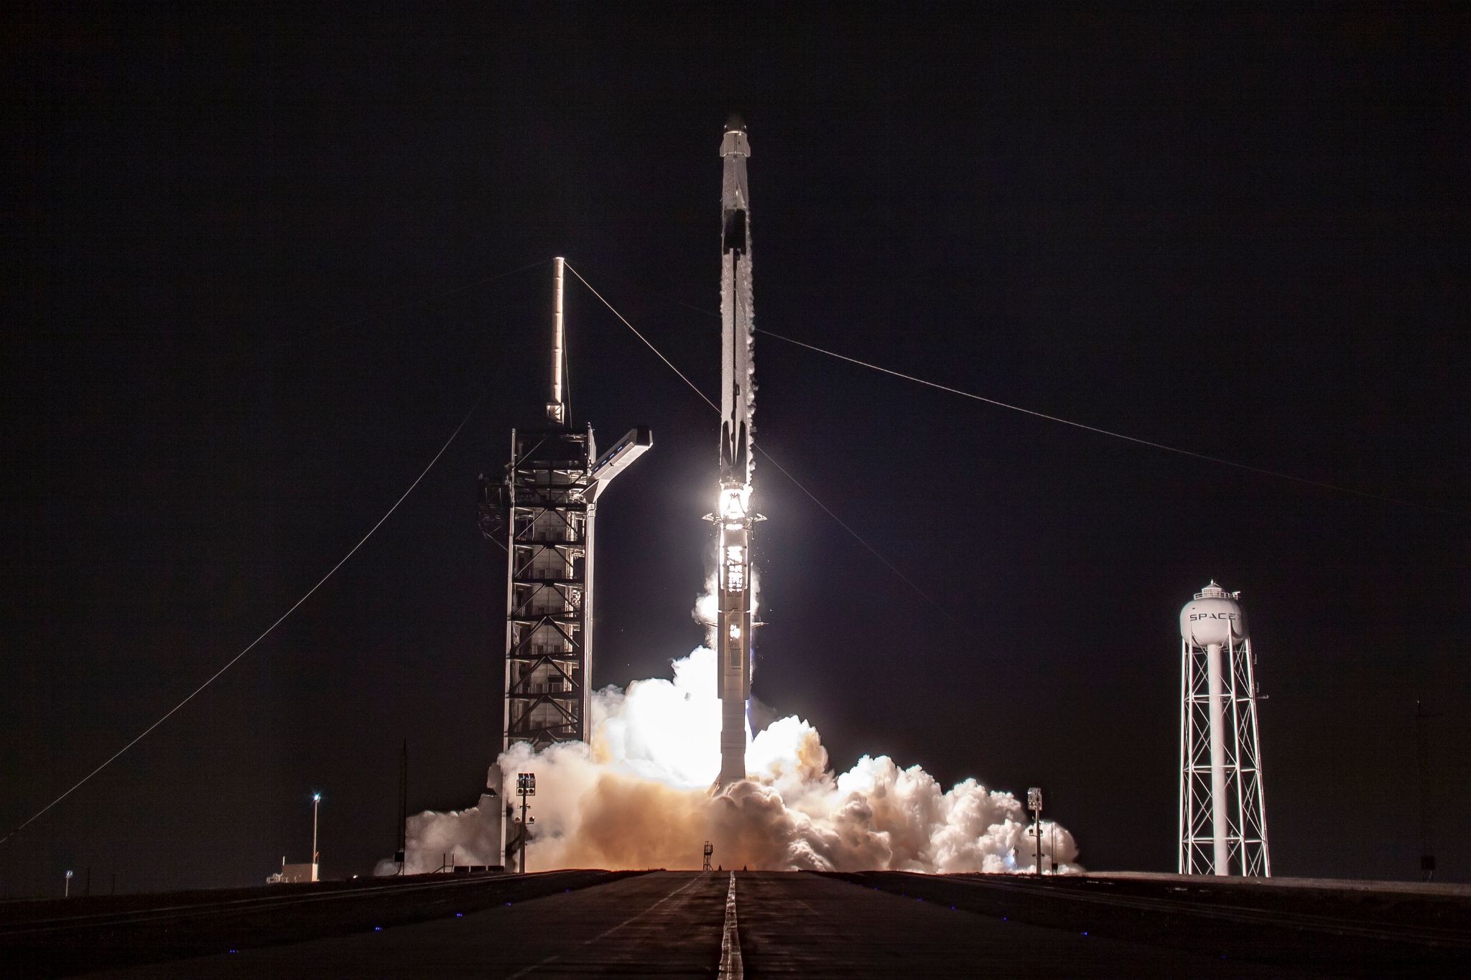
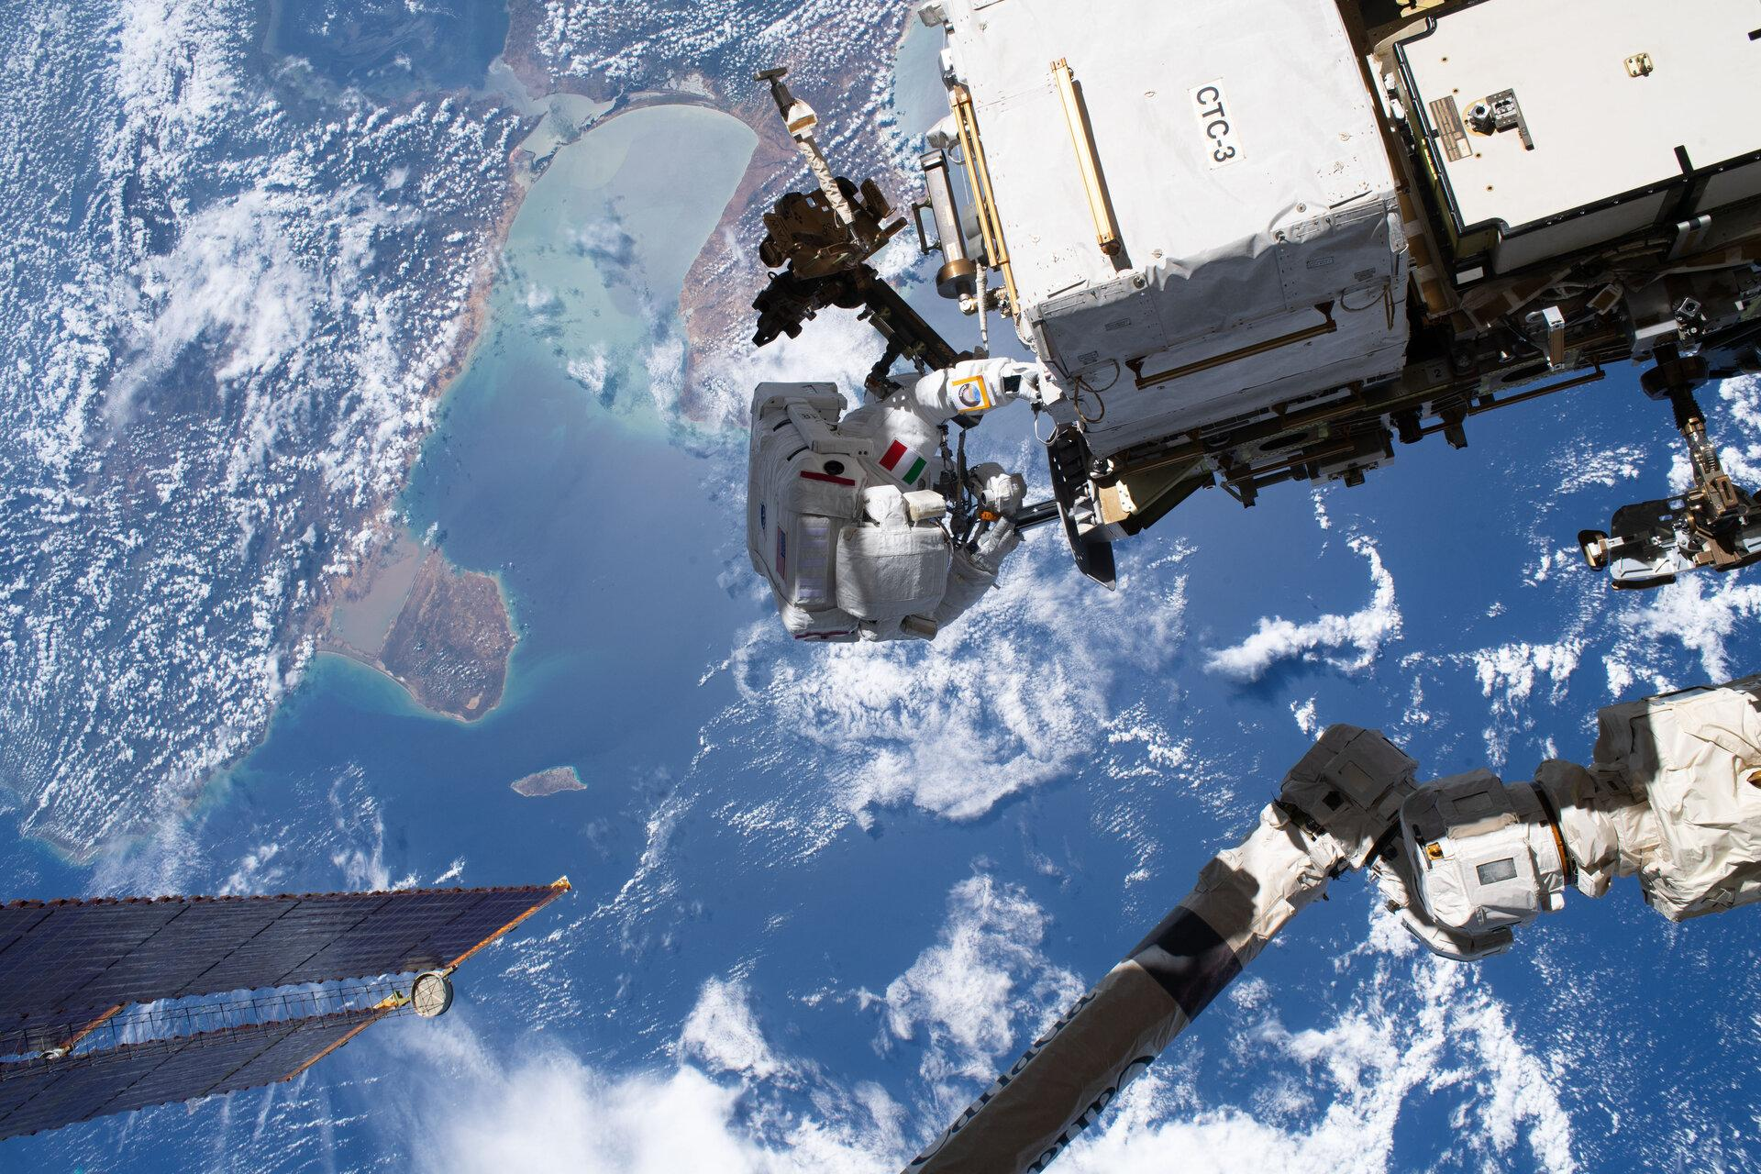
SpaceX’s twitter
ESA Astronauts

Slide 17
FUNCTIONALITY
#1
#2
#3
As a user, the website must be easy to handle. The webpage will have a menu where everything is listed and the user can choose to look at whichever they want to with no problems.
Everyone hates it when they go to a website and they cannot look at it without creating an account first, so that one will be ditched.
Also pop ups must be limited if not completely avoided and they should be related to the context of the webpage.
Must be accessible from phones as well therefore the design should be created differently for a PC’s screen and a phone screen.

Slide 18
How PAGES WILL BE CONNECTED
& INTERACT
The interaction of the pages is very important, for this project links and menu will be the main points of interaction.
Right next to the website’s name the menu bar will be found, when clicking whatever category the user must be directed to that point possibly without the need of a new tab as they are still at the website.
However by clicking on links they must be redirected to those websites. For example as my website will be including news from other space agencies, when I put the link under the news, the user must be able to reach to that official website’s news for more detailed explanation.

Slide 19
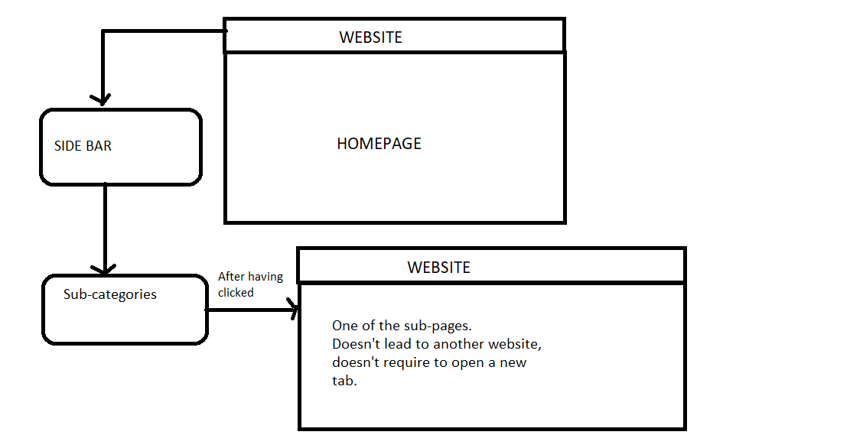
The website will have a bar or menu on the left side which will include more content. The homepage will be more general and vague information, scrolling down the bar there will be different categories such as
Solar System
Exoplanets
….. Theory
etc .
When clicking any of them the user must be led to the according subpage within the same website and tab, so they don’t have to open & close a tab everytime they want to navigate somewhere.

Slide 20
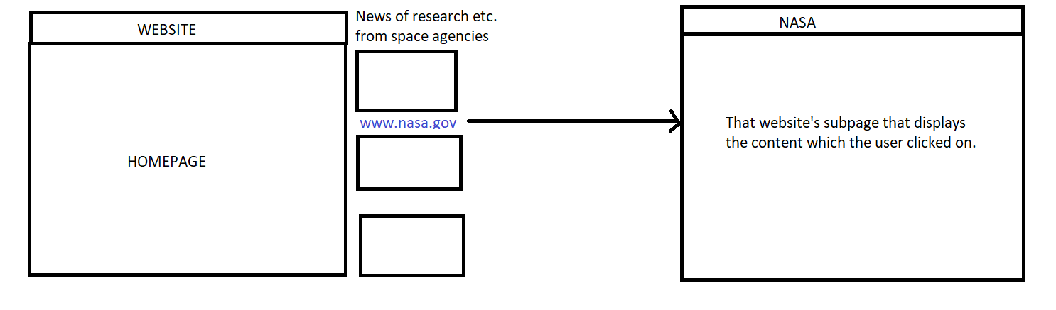
However, when clicking on the news the user must be lead to the page where that news
belongs to so they can read more about it.

Slide 21
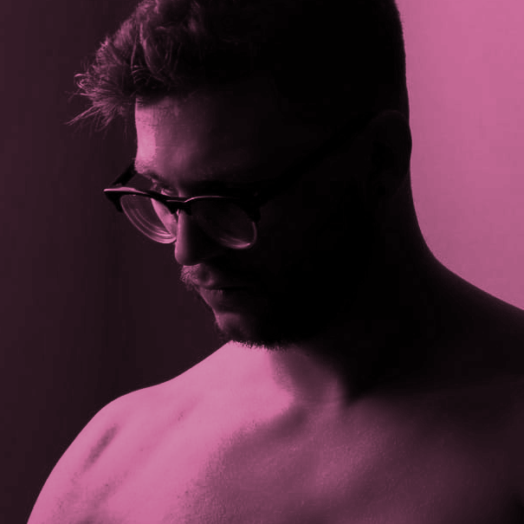
CLIENT’S
SIDE

Slide 22
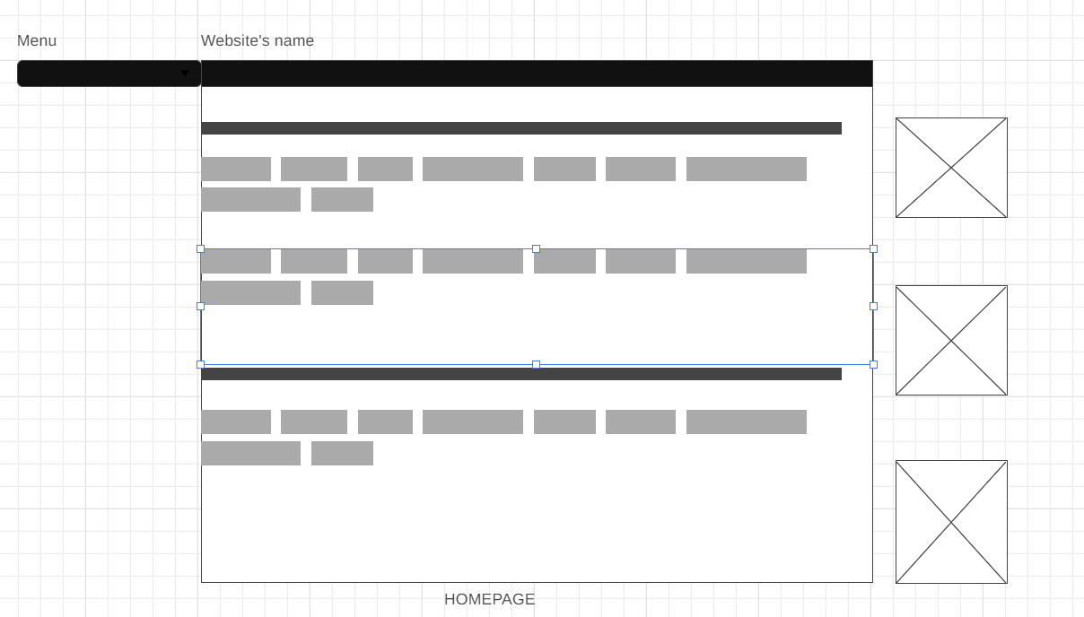
Alternatıve homepage THEMES
dark themed

Slide 23
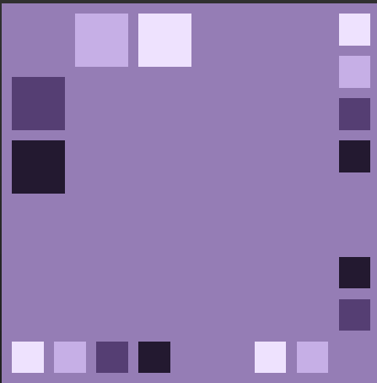
For more colorful ideas, pastel violet-purple can be used. This looks very similar to the Universe app on androids.
In certain places black and white will be used.

Slide 24
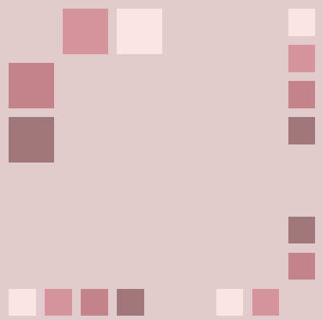
One more alternative is using hues of brown and beige. The only problem might be that the brown color itself reminds more of Earth rather than exoplanets or space in general.

Slide 25
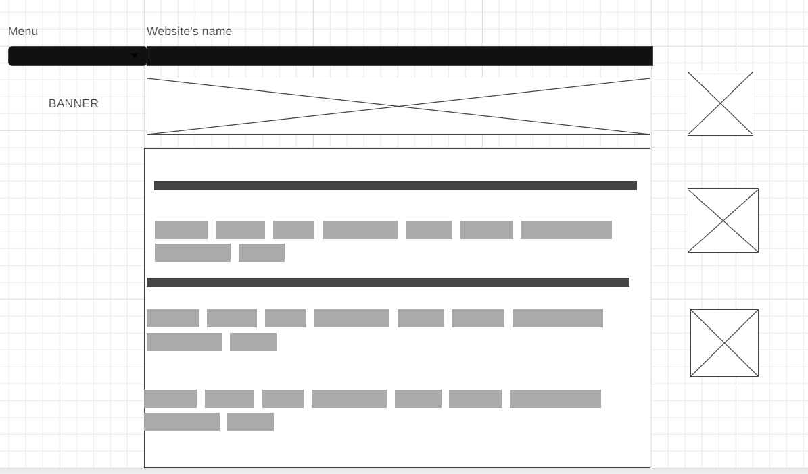
Alternatıve homepage DESIGNS
Banner is included.

Slide 26
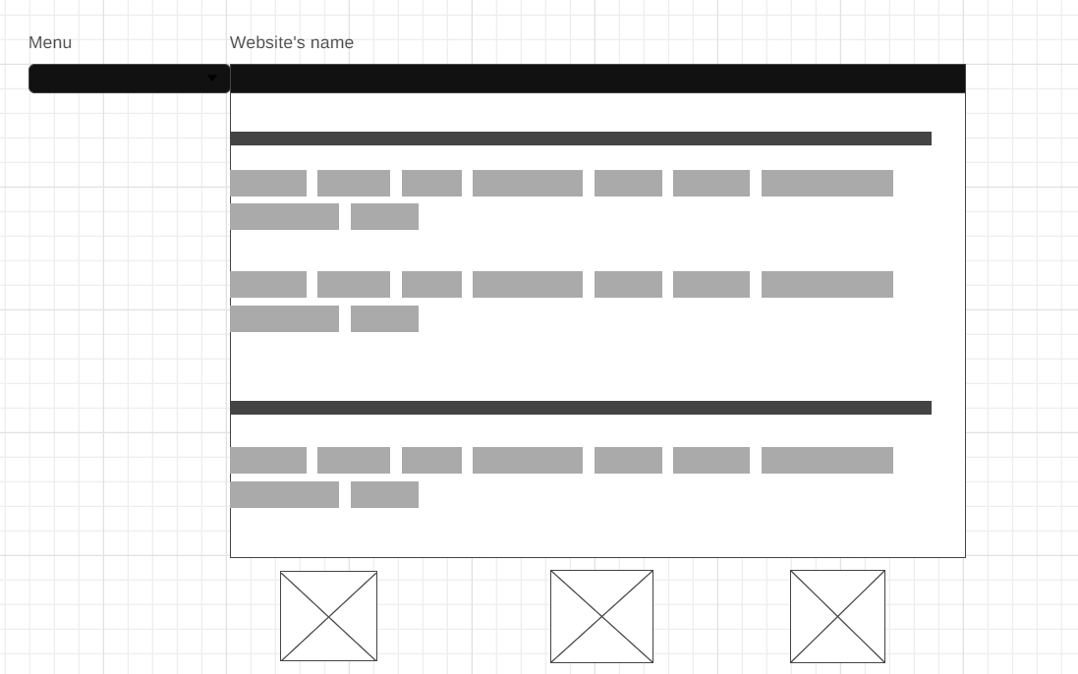
The news is at the bottom.

Slide 27
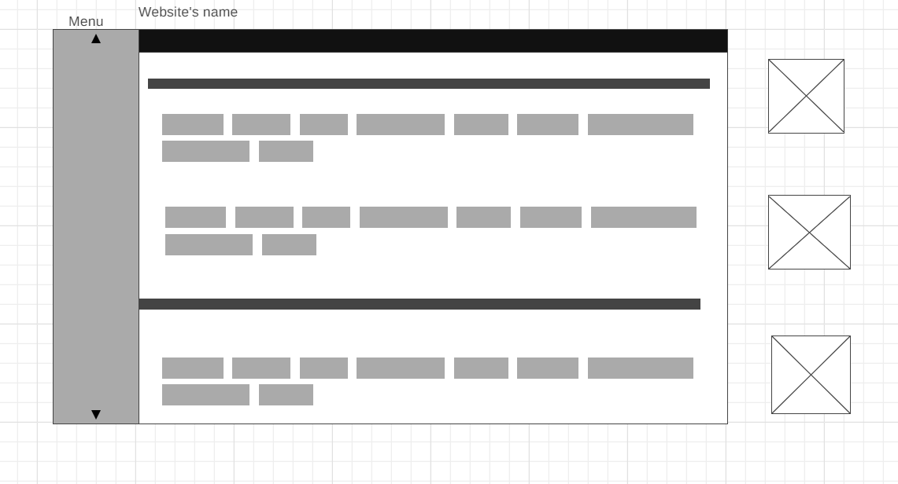
The menu has an up and down button

Slide 28
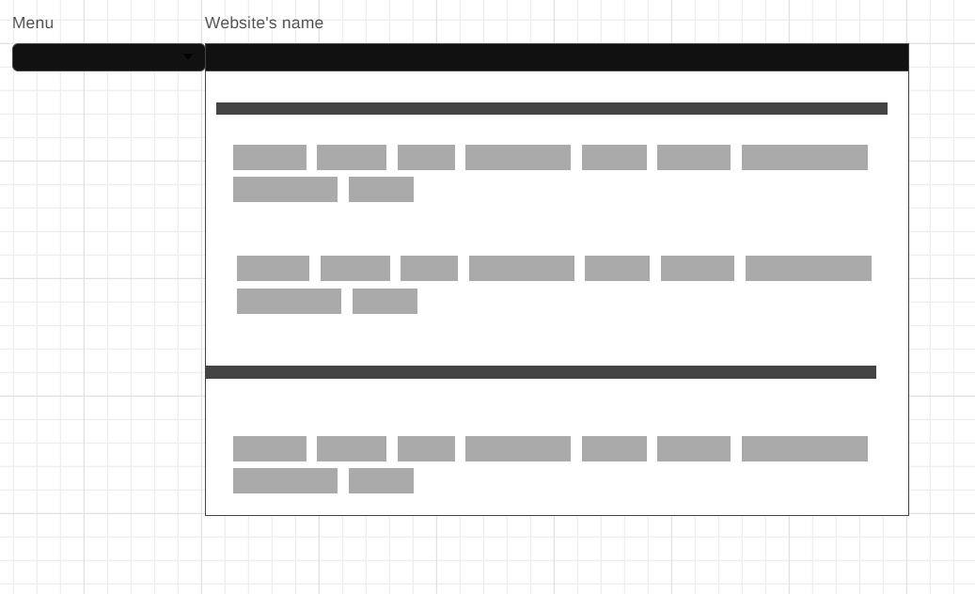
In this case, there is no news from other websites or space agencies.

